Slide 1
ORGANISATIONAL BEHAVIOUR

Slide 2
Major Traits Influencing Organisational Behaviour
Authoritarianism :

Slide 3
It is a generic term used to describe an individual who has strong belief in the legitimacy of established mechanisms of formal authority,
Exhibits a negative philosophy of people,
Adheres to conventional and traditional value systems,
Rigid in their positions,
Place high moral value on their beliefs
Strongly oriented towards conformity to rules and regulations.
Prefer autocratic or directive leadership
Exhibit high respect for individuals in positions of authority.

Slide 4
Locus of Control

Slide 5
It refers to an individual’s belief that events are either within one’s control (internal locus of control) or are determined by forces beyond one’s control (external locus of control).
Externals (those who believe that events are determined by external forces)
less satisfied with their jobs,
Higher absenteeism rates,
More indifferent from work setting
Less involved on their jobs than internals
Internals (those who believe that events are within one’s control).
More control over their own behaviour
More active in seeking information to make decisions
More active socially than externals

Slide 6
Major Traits Influencing Organisational Behaviour

Slide 8
Machiavellianism
It refers to an individual propensity to manipulate people to achieve their self interest .
Participate in organizational politics i.e manipulating system to their advantage.
They are also involved in interpersonal game playing, power tactics and identifying influence system in organizations.
In jobs that require bargaining skills (such as labour negotiation) or where there are substantial rewards for winning (commissioned sales), Machiavellians perform better.

Slide 9
Introversion and Extroversion

Slide 10
These terms are normally associated with an individual’s sociability and interpersonal orientation.
Extroverts are sociable individuals
Introverts are shy, quiet and retiring.
Introverts and Extroverts have different career orientations and require different organizational environments to maximize performance.
Extroverts are more suitable for positions that require considerable interaction with others, whereas introverts are more inclined to excel at tasks that require thought and analytical skills.
Managerial positions are dominated by extroverts
This managerial trait is a factor of managerial success.

Slide 11
Achievement Orientation

Slide 12
Employees with a high need to achieve,
Continually strive to do things better.
Overcome obstacles,
They want to feel that their success or failure is due to their own actions. i.e likes tasks where the outcome can be directly attributed to his or her efforts.
Task with high risk is not liked by these people as the failure rates are more.
Looks for challenges having approximately a 50-50 chance of success on the job,
High achievers tend to do better in sales, sports or in management

Slide 13
Self-esteem

Slide 14
It refers to feeling of like or dislike of one-self that varies from person to person.
Self- esteem is directly related to desire for success.
People with high self-esteem
Have abilities to undertake challenging jobs.
People with low self-esteem
More susceptible to external influence ,dependent on the receipt of positive evaluation from others.
In managerial positions, low esteems will tend to be concerned with pleasing others, and therefore less likely to take unpopular stands than high esteems.
Self-esteem is also related to job satisfaction. High esteems are more satisfied with their jobs than the low esteems.

Slide 15
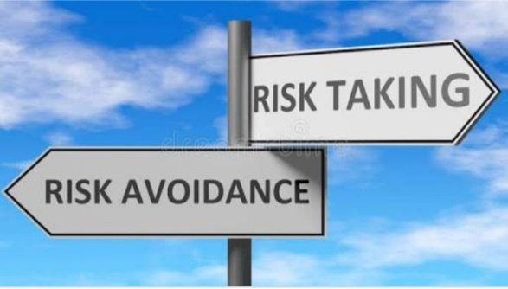
Risk-taking
People differ in their willingness to take chances or risk
Their propensity to assume or avoid risk affects managers making decisions.
High-risk-taking managers made more rapid decisions and used less information in making their choices than did low-risk- taking managers.
For instance, a high-risk-taking propensity
- stock trader in a brokerage firm.
This type of job, demands rapid decision-making.
Low-risk taking propensity accountants performing auditing activities.

Slide 16
Self-Monitoring

Slide 17
It refers to an individual’s ability to adjust his or her behaviour to external factors.
Individuals high in self-monitoring
Show considerable adaptability in adjusting their behaviour to external, situational factors.
Capable of presenting striking contradictions between their public, personal and their private selves.
They will be more successful in managerial positions where individuals are required to play multiple and even contradicting roles.
Capable of putting on different “faces” for different audiences.

Slide 18
Low self- monitors cannot deviate their behaviour.
They tend to display their true dispositions and attitude in every situation, hence there is high behavioural consistency between who they are and what they do.

Slide 19
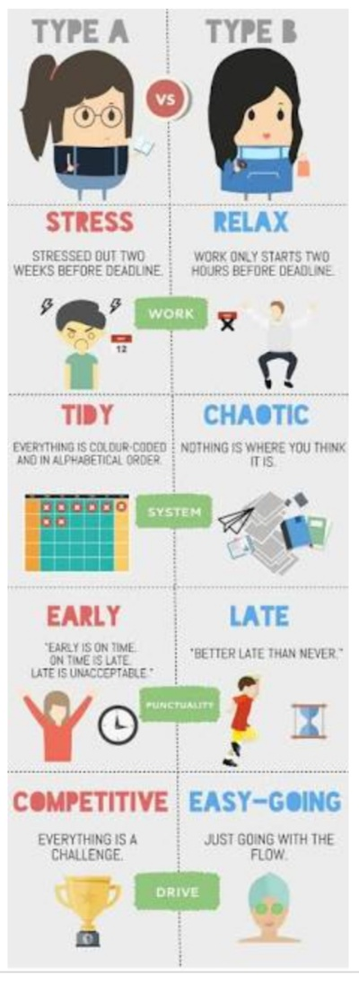
Type ‘A’ Personality and Type ‘B’ Personality

Slide 20
Type A personality
Person who is always in a hurry
Extremely competitive
Often hostile and irritable.
Highly competitive and hardworking
Make most successful sales people and senior executive

Slide 21
Type B personality
Relaxed,
Incompetent and
Easy going.
Climbs up to the top of organization. Why because Type A’s to trade off quality of effort for quantity.
Executive positions usually go to those who are patient rather than to those who are merely hasty, to those who are tactful rather than to those who are hostile and to those who are creative rather than to whose who are merely agile in competitive strife.

